Slide 1


CSE 455 SOFTWARE TESTING
Lecture 14
This course is offered to the students of students of BS Software Engineering who are enrolled in 8th semester

Slide 2
COURSE INSTRUCTOR YELLA MEHROZE
yellamehroze@cuilahore.edu.pk

Slide 3
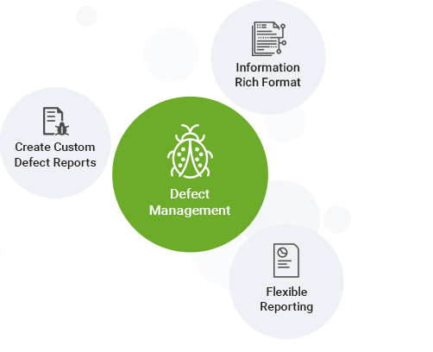
TOPIC: BUG’S REPORTING

Slide 4
Outline
Objectives of Bug Reporting
Introduction
Getting Your Bugs Fixed
Importance of Good Bug Reporting
Characteristics of Good Bug Reporting
Fundamental Principles for Reporting Bugs
Isolating and Reproducing Bugs
Bug’s Severity
Bug’s Severity and Priority
Test Incident Report

Slide 5
Objectives of Bug Reporting
To provide the ability to track bugs/problems
To state the problem as clearly as possible so that developers can replicate the bug easily and fix it.
To provide standardized and custom query/reporting capabilities
To provide integration to software Version Management system

Slide 6
Introduction
Software Testing Tasks
Test Planning
Actual Testing
Reporting What You Find
It seems that reporting what you find is simple and less time-consuming job but sometimes it is the most difficult task you perform as a tester

Slide 7

Getting Your Bugs Fixed
All bugs are not fixed and are normally
Dismissed
Deferred
The reasons for not fixing a bug
There’s not enough time
It’s really not a bug
Its too risky to fix
It’s just not worth it
Ineffective bug reporting
Notes:
Deferred means postponed for fixing in next release
The reasons for not fixing a bug include:
There’s not enough time (Already Discussed)
It’s really not a bug (Already Discussed)
Its too risky to fix (Already Discussed)
It’s just not worth it (Already Discussed)
Ineffective bug reporting (We will study it in the next slide)

Slide 8
Getting Your Bugs Fixed
Ineffective bug reporting- The tester did not make a strong enough case that a particular bug should be fixed.
So the bug was misunderstood as
Not being a bug
Was deemed not important enough to delay the product
Was thought to be too risky to fix
Was just plain considered to be not worth fixing

Slide 9
Importance of Good Bug Reporting
“The purpose of reporting a defect is to get it fixed.”
Cem Kaner

Slide 10
Importance of Good Bug Reporting
A badly written bug report wastes time and effort for many people
A concisely written, descriptive report results in the elimination of a bug in the easiest possible manner
For testers, bug reports are primary deliverable for their work
The quality of a bug report is a direct representation of the quality of testers’ skills
Bug report should be good enough because it may be distributed beyond the immediate project team
i.e. various levels of management within different organizations

Slide 11
Characteristics of Good Bug Reporting
Characteristics of Good Bug Reporting
Minimal
Singular
Obvious and General
Reproducible

Slide 12
Characteristics of Good Bug Reporting
Minimal
It explains just the facts and details necessary to demonstrate and describe the bug.
Give an exact sequence of steps that show the problem.
If more than one set of inputs or actions cause the bug, cite a couple of examples.
Be short and to the point.
Example: In case of multiple paths, mention the exact path you followed: Let’s say A, B, C and X, Y, Z are paths. Do not say something like “If you do ‘A and X’ or ‘B and Y’ or ‘C and Z’, you get D.” Understanding all the paths at once will be difficult. Instead, say “Do ‘A and X’ and you get D.” You can, of course, mention elsewhere in the report that “D can also be got if you do ‘B and Y’ or ‘C and Z’.”

Slide 13
Characteristics of Good Bug Reporting
Singular
There should be only one bug per report.
It is sometimes difficult to differentiate between similar looking bugs
Misspelled words on 15 different pages
The login dialog won’t accept passwords or login IDs with upper case characters
The problem with reporting more than one bug in a single report is that
It’s only the first bug that gets attention and is fixed
Other become forgotten or ignored
Tips:
When in doubt, enter individual bugs
You are looking for symptoms, not causes.
Several bugs may turn out to have same cause, but you cannot know that until the bug is fixed.

Slide 14
Characteristics of Good Bug Reporting
Obvious and General
A bug described with numerous complex steps that shows a very specific instance of a bug is less likely to get fixed
A bug described with easily performed steps that show the bug to be very general and readily seen by a user is most likely to get fixed
Bug isolation should be done and identify the keystrokes on which bugs occur
Example: Specify the exact action: Do not say something like ‘Select ButtonB’. Do you mean ‘Click ButtonB’ or ‘Press ALT+B’ or ‘Focus on ButtonB and click ENTER’? Of course, if the defect can be arrived at by using all the three ways, it’s okay to use a generic term as ‘Select’ but bear in mind that you might just get the fix for the ‘Click ButtonB’ scenario

Slide 15
Characteristics of Good Bug Reporting
Reproducible
Put on your detective hat and follow a predefined set of steps that will cause the software to achieve the same states and the bug to occur again.
There is no such thing as a random software bug.
If you create the exact same situation, with exact same inputs, the bug will reoccur
However identifying and setting up that exact same situation and exact same inputs is tricky
The difficulty is to try to isolate and reproduce what seems like
Random software behavior
Occasional crashes
By chance data corruption and so on
However, if you cannot replicate it again after many trials, finally submit the report for further investigation, stating that you are unable to reproduce the defect anymore and provide any evidence of the defect if you had gathered.

Slide 16
Fundamental Principles for Reporting Bugs
Fundamental principles for reporting bugs
Report bug as soon as possible
Effectively describe the bugs
Be non-judgmental in reporting bugs
Follow up on your bug reports

Slide 17
Fundamental Principles for Reporting Bugs
Report bug as soon as possible
The earlier you find a bug, the more time it remains in the schedule to get it fixed
Example- Suppose that you find misspelling in a help file a few months before the software is released. That bug has a very likelihood of being fixed. If you find the same bug a few hours before the release, odds are it won’t be fixed.
The bug is still the same bug whether you find it today or three months from now
The risk of fixing the bug go up over time

Slide 18
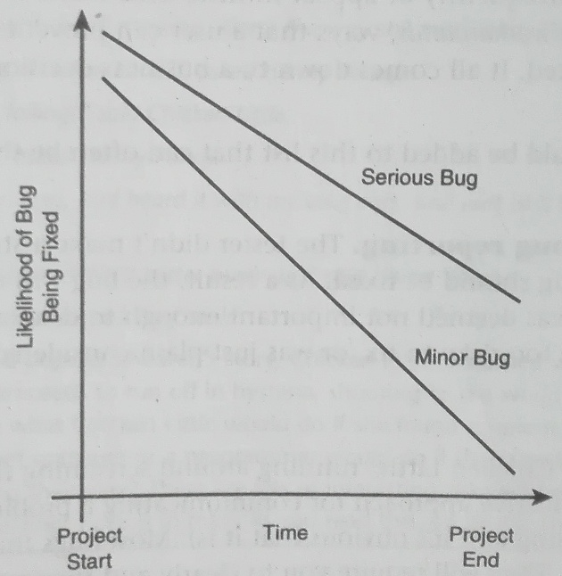
Report bug as soon as possible
Notes:
In this graph you can see Time on x axis and Likelihood of Bug Being Fixed on y axis. When project has just started, the likelihood of bug being fixed for serious bugs is very high and for minor bugs is also high. But at the end of project the likelihood of minor bug being fixed is very low or you can say you will have to ignore these bugs at this time. However at this time the likelihood of serious bugs being fixed is comparatively much high compared to the minor bugs.

Slide 19
Fundamental Principles for Reporting Bugs
Effectively describe the bugs
Example- Suppose that you were a programmer and received the following bug report from a tester
How would you begin to fix it without knowing
‘Whenever I type a bunch of random characters in the login box, the software starts to do weird stuff’.
What random characters were entered?
How big a bunch was?
What kind of weird stuff was happening?

Slide 20
Fundamental Principles for Reporting Bugs
Be non-judgmental in reporting bugs
Bug reports can be viewed by the programmers and others on the development team.
Tester’s need to be
non-judgmental
non-personal
non-inflammatory
Bug reports should be written against the product, not the person
State only the facts
There should be
No gloating
No egos
No accusations
Tact and diplomacy are what matters
Notes:
Non-judgmental -> means not creating a biased perception about a person.
Non-personal -> Means not writing anything that is biased in the report.
The difference between judgmental and personal is that judgmental is more perceptual while personal is more towards vocal.
Non-inflammatory -> Being proud at what he has found.
Gloating-> Means you should not enjoy your finding of bugs
Egos-> The most important point that a tester should keep in mind is not to use a commanding tone in the report. This breaks the morale and creates an unhealthy work relationship. Use a suggestive tone.
Accusations-> Don’t assume that the developer has done a mistake and hence you can use harsh words.

Slide 21
Fundamental Principles for Reporting Bugs
Follow up on your bug reports
The worst thing is finding a bug, reporting it and then forgetting about it or losing track of it.
Don’t let the results of your labor and the bugs you find become neglected.
A good tester finds and logs lots of bugs
A great tester finds and logs lots of bugs but also continues to monitor them trough the process of getting them fixed.

Slide 22
Isolating and Reproducing Bugs
In situations where bug isolating or reproducing is difficult, try following suggestions
Keep notes of everything you do-every step, every pause, everything
Look for time- dependent and race condition problems.
White box issues of boundary condition bugs, memory leaks and data over-flows can be slow to reveal themselves.
State bugs show up only in certain states of the software. These bugs may look like a time-dependent or race condition problem but you'll find that time is unimportant. It is the order in which the things happen not when they happen
Consider resource dependencies and interactions with memory, network, and hardware sharing
Do not ignore the hardware. Hardware can degrade and act unpredictably. A loose card, a bad memory chip, or an overhead CPU can cause failures that look like software bugs but really are not.
Notes:
Step 1: Use a recording program so that you can record and playback your steps exactly. Use a video camera to record your test session if necessary. The goal is to make sure that every detail of the steps necessary to cause the bug are visible and can be analysed.
Step 2: Time dependent means does the bug occur only at a certain time of day? Maybe it depends on how quickly you enter the data or the fact that you're saving data to a slower floppy instead of a fast hard drive. Was the network busy when you saw the bug? Try your test case on slower or faster hardware. Think timing.
Whereas race condition is an undesirable situation that occurs when a device or system attempts to perform two or more operations at the same time, but because of the nature of the device or system, the operations must be done in the proper sequence in order to be done correctly.
Step 5: Does the bug occur only on a "busy" system that is running other software and communicating with other hardware?
Step 6: Try to reproduce your bugs on different hardware. This is especially important if you're performing configuration or compatibility testing. You'll want to know if the bug shows up on one system or many.

Slide 23
Bug’s Severity
Bug’s severity should be assessed in terms of Impact and Probability
Impact
Probability
Is the measure of seriousness of the bug
Can be classed as high or low
Probability is a measure of how likely the bug is to occur
Again is assigned either “Low” or “High”.

Slide 24
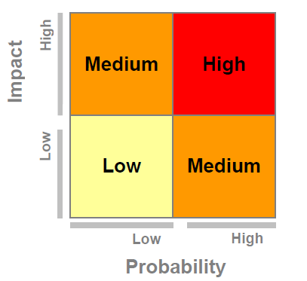
Bug’s Severity
Notes:
In this graph you can see that when probability is low and impact is low the severity of the bug is also low. When probability is high and impact is low the severity of the bug is medium. When probability is low and impact is high the severity of the bug is also medium. When probability is high and impact is high the severity of the bug is also high.

Slide 25
Bug’s Severity and Priority
Do you agree?
A bug that corrupts a user’s data is more severe than one that’s a simple misspelling
What if?
Data corruption occurs very rarely and the misspelling causes every user to have problems installing the software
Severity indicates:
How bad the bug is and reflects its impact to the product and to the user
Priority indicates
How important it is to fix the bug and when it should be fixed
Notes:
Do You Agree? Off course you will agree.
What if? In terms of data severity the probability of data corruption error is low but its impact is high the defect severity is medium. Misspelling has high probability of occurrence and its impact in this scenario is also high so the defect severity is high.

Slide 26
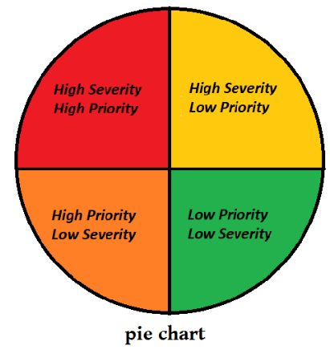
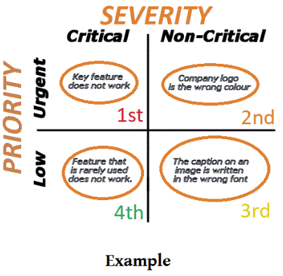
Bug’s Severity and Priority
Severity
1- System crash, data loss, data corruption
2- Operational error, wrong result, loss of functionality
3- Minor problem, misspelling, UI layout, rare occurrence
4- Suggestion
Priority
1- Immediate fix, blocks further testing, very visible
2- Must fix before the product is released
3- Should fix if time permits
4- Would likely to be fixed but can be released as is
Note: A bug’s priority can change over the course of a project

Slide 27
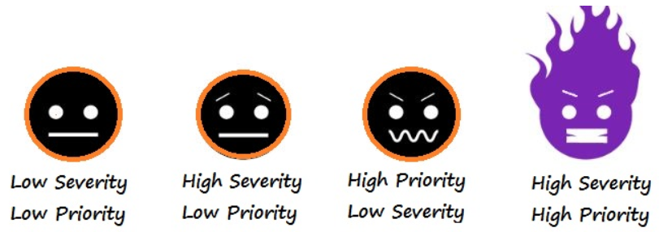
Bug’s Severity and Priority
Low Priority, Low Severity: Any cosmetic or spelling issues which is within a paragraph or in the report
Low Priority, High Severity: Web page not found when user clicks on a link (user does not visit that page generally)
High Priority, Low Severity: When the company’s name is misspelled in the home page of the website.
High Priority, High Severity: An error which occurs on the basic functionality of the application and will not allow the user to use the system (E.g. user is not able to login to the application)

Slide 28
Test Incident Reporting
Test incident report is used to document any event that occurs during the testing process which requires investigation. In short, to log a bug.

Slide 29
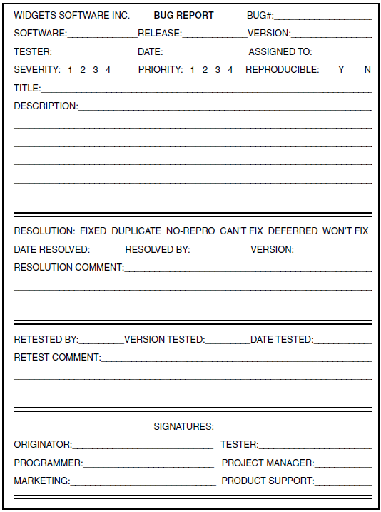
MANUAL BUG REPORTING AND TRACKING
Notes:
There are four sections of the bug report separated by lines.
First section contains the following features and it should be filled by tester.
Bug#:Specifies an ID that’s unique to the bug report that can be used to locate and refer to it.
Release: is the distribution of the final version of an application. A software release may be either public or private.
Version: Version number of the module or software that is tested.
Tester: Here you will write the name of the tester.
Date: at which the bug is being reported.
Assigned to: Mention the name of the developer who is assigned to the bug for correction.
Severity: Based on the severity levels and examples discussed in the previous slides, you select the severity of the bug.
Priority: Based on the priority levels and examples discussed in the previous slides, you select the priority of the bug.
Reproducible: You select Y if the bug is reproducible otherwise N.
Title: Mention the title of the bug. It should say all about what comes in the bug.
Description:
Detailed description of the defect. Describe as much as possible but without repeating anything or using complex words. Keep it simple but comprehensive. It also includes:
Procedure steps
Example:
Select product Abc01.
Click on Add to cart.
Click Remove to remove the product from the cart.
Inputs Details
Expected results
Actual results
Attachments
Second section contains the following features and should be filled by programmer after he resolves the bug.
Resolution: Programmer can select any of the given options.
Date Resolved: The date at which the bug is resolved by the programmer.
Resolved By: Here the programmer who resolved the bug, mentions his name.
Version: If the correction of bug results in a new version of the software or module, mention it here.
Resolution Comments: The programmer gives his comments on the bug he has to resolve or he has resolved.
Third section contains the following features and should be filled by tester when he has to confirm the fix.
Retested By: Name of the tester who retested the product feature to make sure the bug is fixed.
Version Tested: Mention the version of the product or module which is being retested by tester.
Date Tested: Mention the date when it is retested.
Retest Comments: The tester gives his comments about the product or module, after he retests it.
Fourth section is the signature section. To close the bug report signature of all stakeholders are mandatory.

Slide 30
References
Chapter #19
Software Testing by Ron Patton Second Edition

